Slide 1

Red Hat System Administration I 10.0
Chapter 2
Dilara Gülenç

Slide 2
Introduction to the Bash Shell
What is Bash?
The Interface: A powerful text-based command-line shell that translates user input into system actions.
The Standard: Default shell for Red Hat Enterprise Linux (RHEL), built as an upgraded release of the classic UNIX Bourne shell (sh).
Automation Core: Goes far beyond basic command execution with a complete scripting language built for large-scale administrative workflows.
vs. Windows: Significantly more powerful than legacy cmd.exe; matches modern PowerShell in automation capabilities.
vs. macOS: Served as the default macOS shell until macOS 10.15 Catalina, which switched to zsh (also supported on RHEL).

Slide 3
Privileges & The Shell Prompt
Regular User Shell | Superuser (root) Shell
Prompt Format: user@host:~$ | Prompt Format: root@host:~#
Indicator: Ends with a dollar sign ($) | Indicator: Ends with a number sign (#)
Access Level: Standard user privileges | Access Level: Unrestricted system-wide control
Safety Note: Safe for daily operations | Safety Note: Critical visual indicator to prevent destructive errors

Slide 4
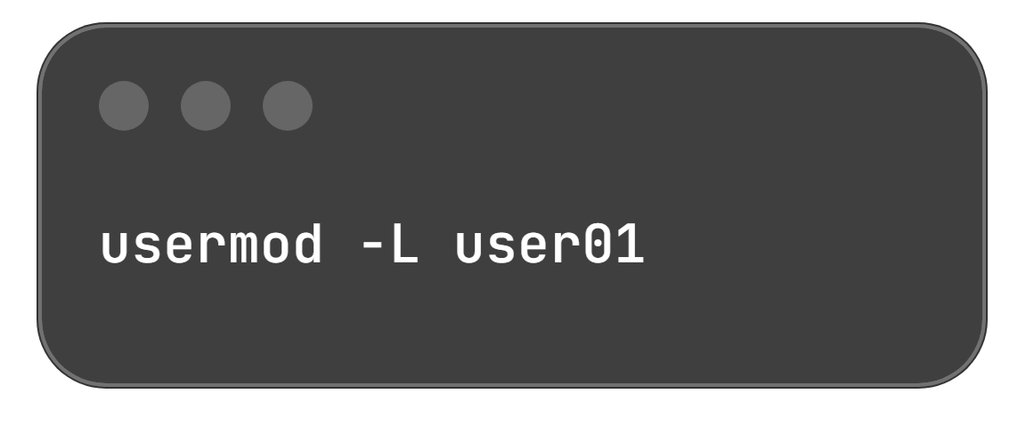
Anatomy of a Linux Command
Command Syntax:
Component Breakdown:
Command (usermod): The binary program to execute.
Option (-L): Modifies execution behavior; begins with - (short) or -- (long). Here, it locks the password.
Argument (user01): The operational target (user, file, or resource) that the command acts upon.
Execution Result: Locks the account password for user01 via a single structured instruction.

Slide 5
Local System Access & Virtual Consoles
Physical Console: Hardware keyboard and display directly connected to the system.
Virtual Consoles: Multiple independent login sessions supported on separate terminals.
Navigation Shortcut: Press Ctrl + Alt + [F1–F6] to toggle between virtual consoles.
Text Prompts: Most virtual consoles offer a text login prompt; entering credentials successfully launches a shell prompt.
tty1: Houses the graphical login screen permanently.
tty2 to tty6: Five text login prompts available by default.
Graphical Session: Starts on the first unused console (typically replaces tty2).
Multi-User Switching: Switching users launches another graphical session on the next free virtual console.
Logout Behavior: Logging out exits that virtual console and automatically reverts the physical display to tty1.

Slide 6
Server Workloads & Headless Administration
Attribute | Graphical Servers | Headless Servers
Hardware Setup | Display & keyboard attached | No permanently connected display or keyboard (saves data center rack space/cost)
Resource Usage | Heavy; significant CPU & RAM consumed by GUI | High efficiency; all resources dedicated strictly to server workloads
Direct Access | Terminal application window running inside the GUI | Serial console running on a serial port via a networked console server
Network Access | Remote Desktop Protocol (RDP) for remote GUI tasks | Conventional network connection (or serial access if network card is misconfigured)

Slide 7
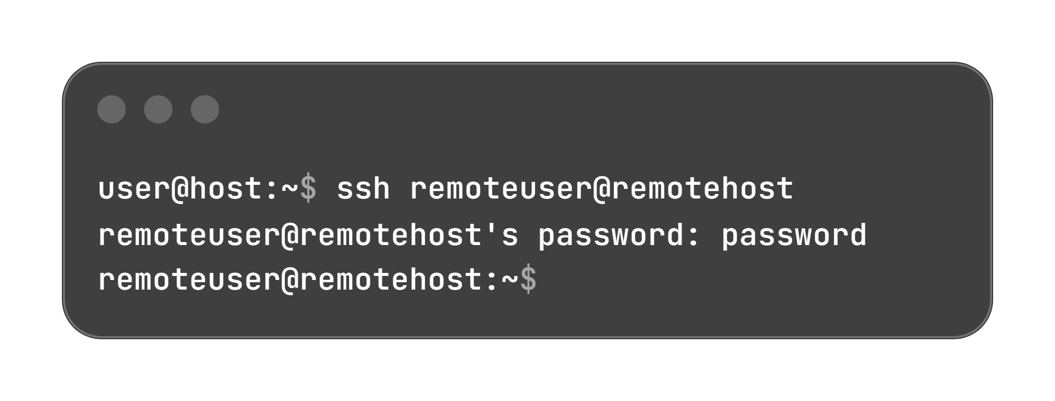
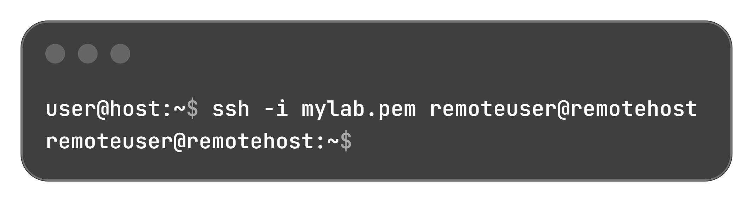
Remote Login via SSH & Authentication
Standard method to access remote Linux systems, virtual machines, and cloud instances.
Powered by OpenSSH (ssh command) on RHEL and macOS.
Fully encrypts the communication channel to prevent eavesdropping and session hijacking.
1. Password Authentication:
2. Public Key Authentication:
Uses a private key file (-i option) kept secret by the client, and a public key installed on the server.
Common on cloud instances where password logins are forbidden.
Permissions Enforcement: OpenSSH strictly blocks insecure keys; only the file owner can have read access:
chmod 600 mylab.pem

Slide 8
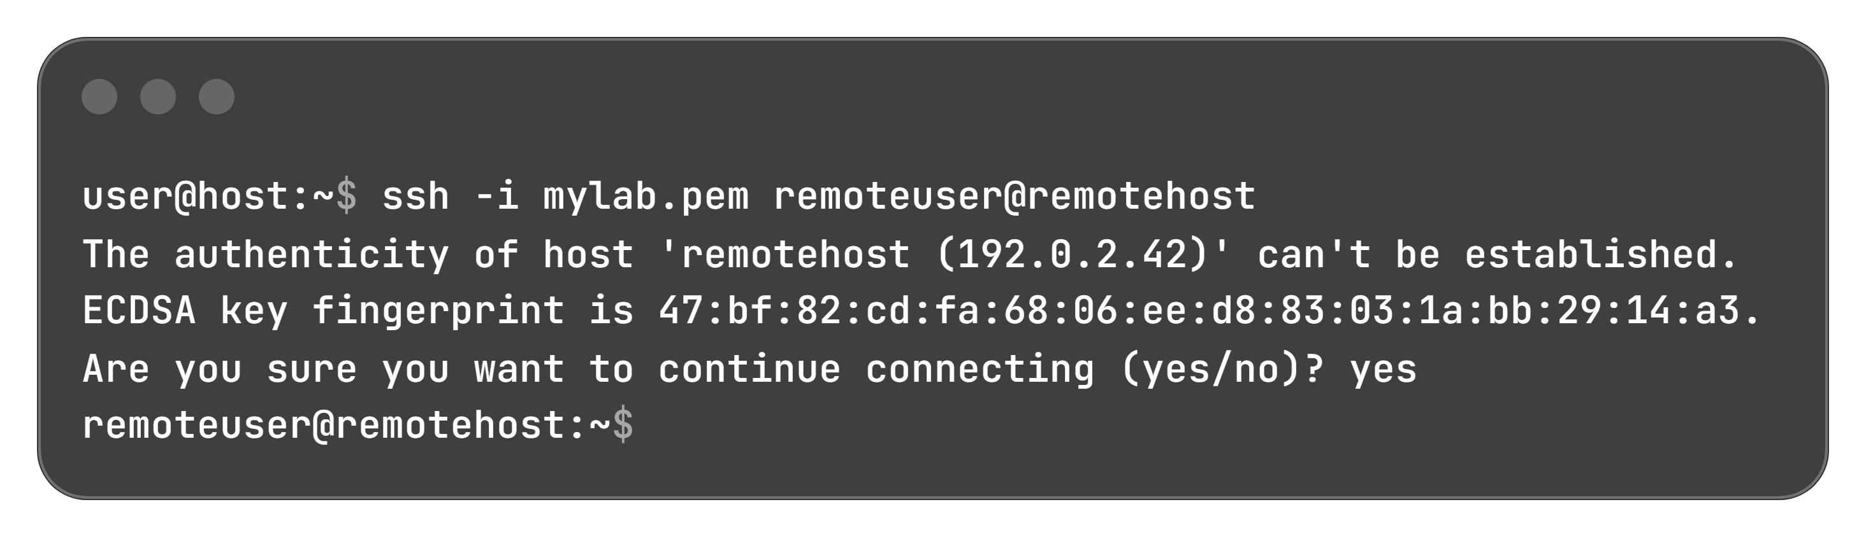
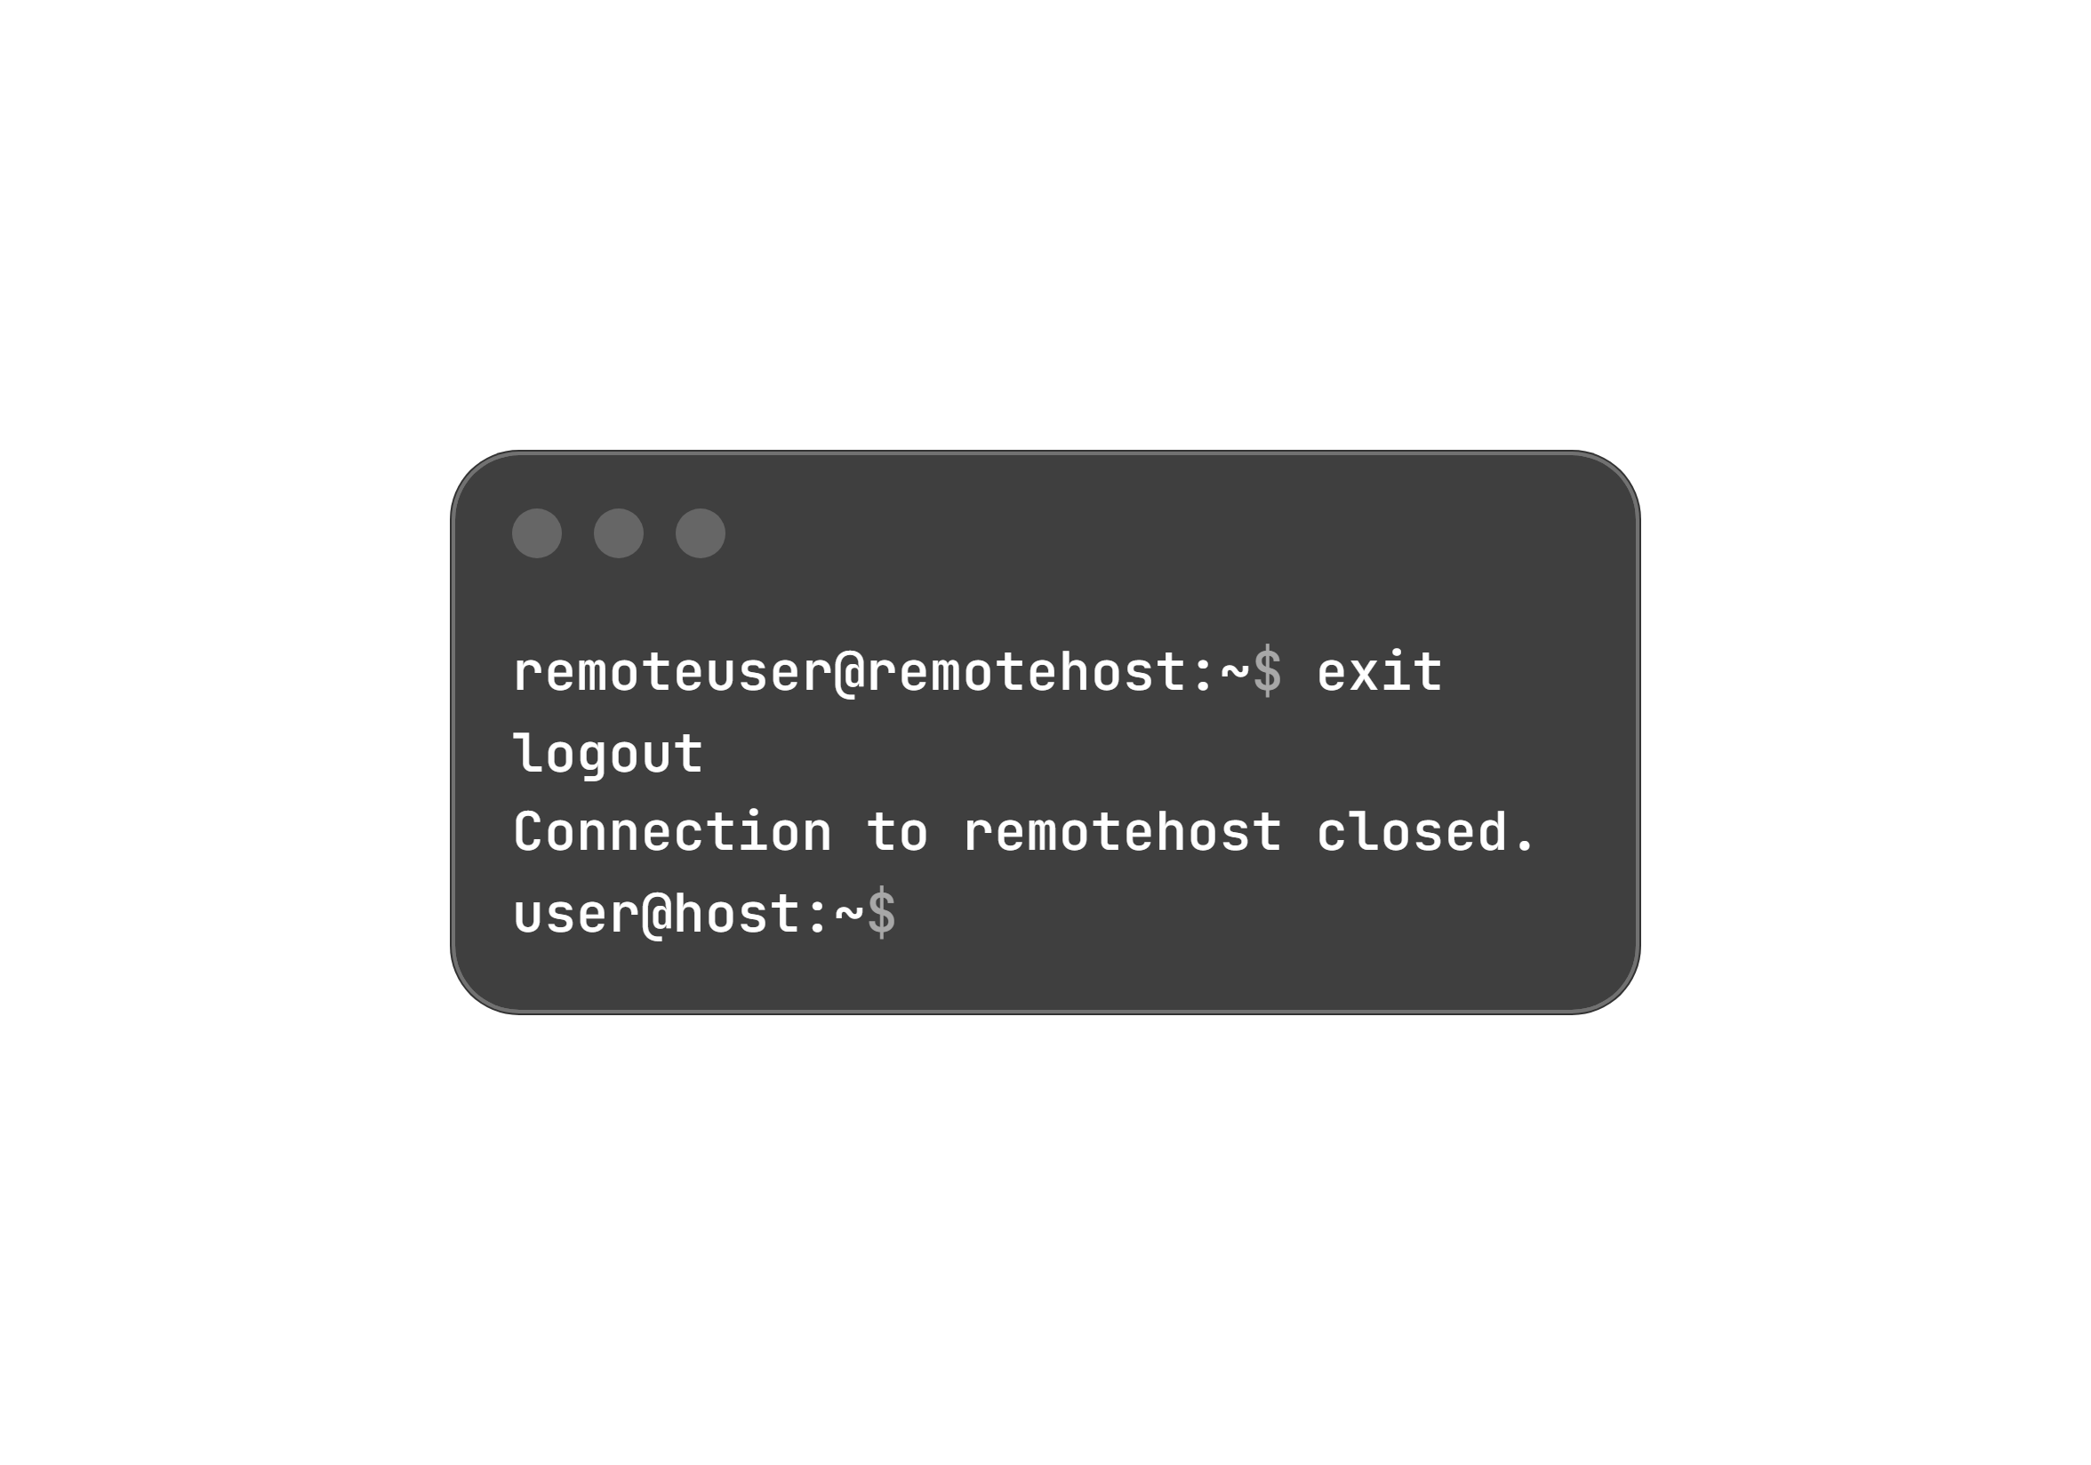
Host Verification & Session Termination
3. Verification Logic:
Enter yes: Key is saved locally for future logins.
Enter no: Key is rejected and connection terminates.
Mismatch detected: Automatic connection drop with warning (signals potential connection hijacking/interceptor attacks).
Ending a Remote Shell Session:
Command Option: Type exit
Keyboard Shortcut: Press Ctrl + D
Initial Host Key Verification (Interceptor Attack Protection):
Key Exchange: The remote host transmits its unique host key upon connection to authenticate itself.
First-Time Warning: If the key is not in the local saved list, SSH prompts for confirmation:

Slide 9
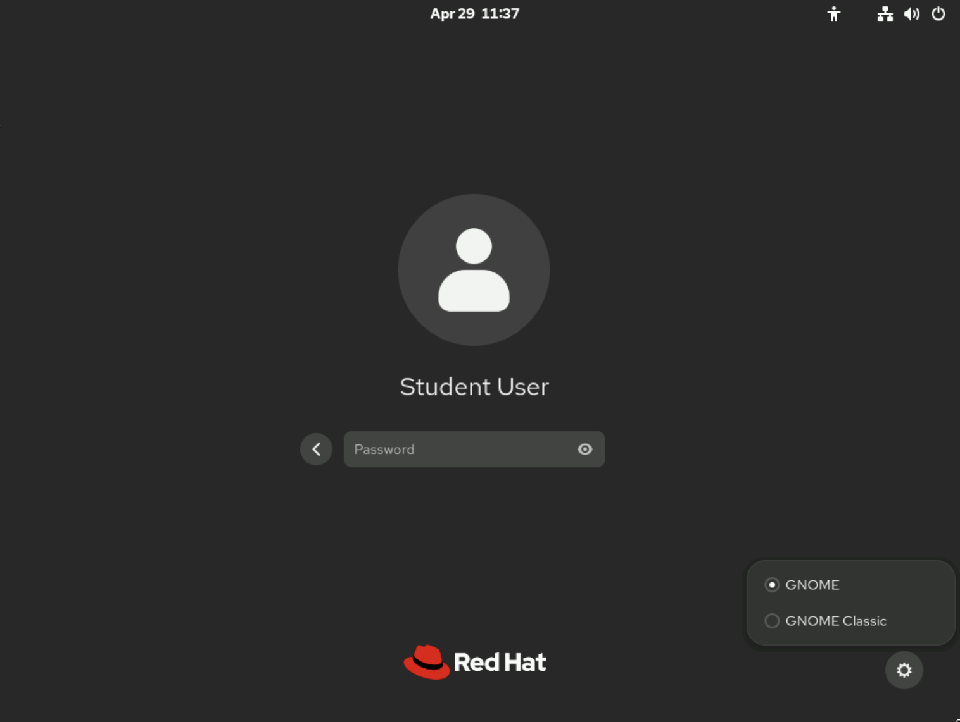
The GNOME Desktop & Interface Overview
Framework: GNOME 47 is the default GUI, powered by the Wayland graphical display framework.
Themes: Default standard GNOME theme; switchable to GNOME Classic via the Settings icon on the login screen.
Tour Program: Automatically launches on first user login to highlight new features (optional, can be closed/skipped).

Slide 10
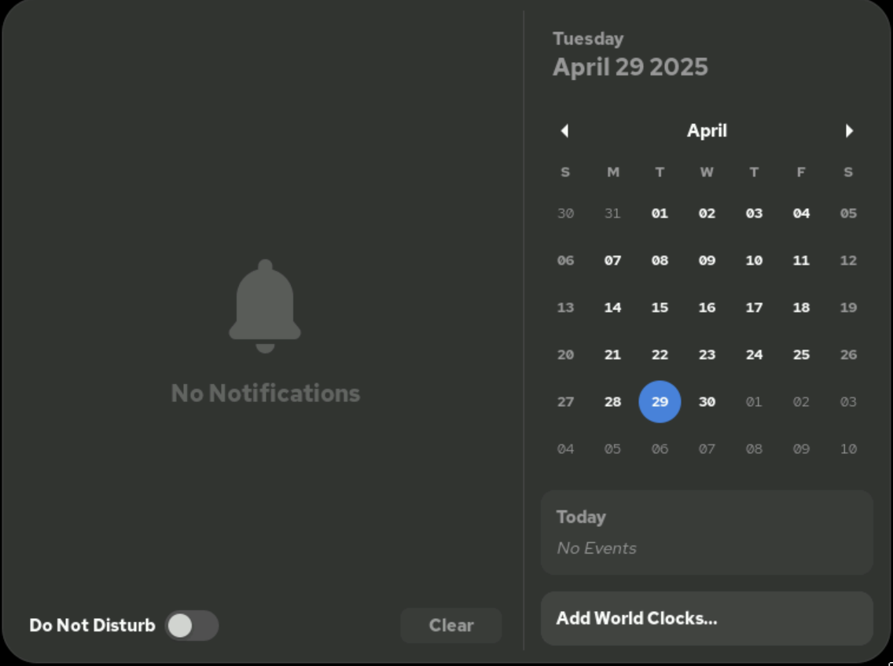
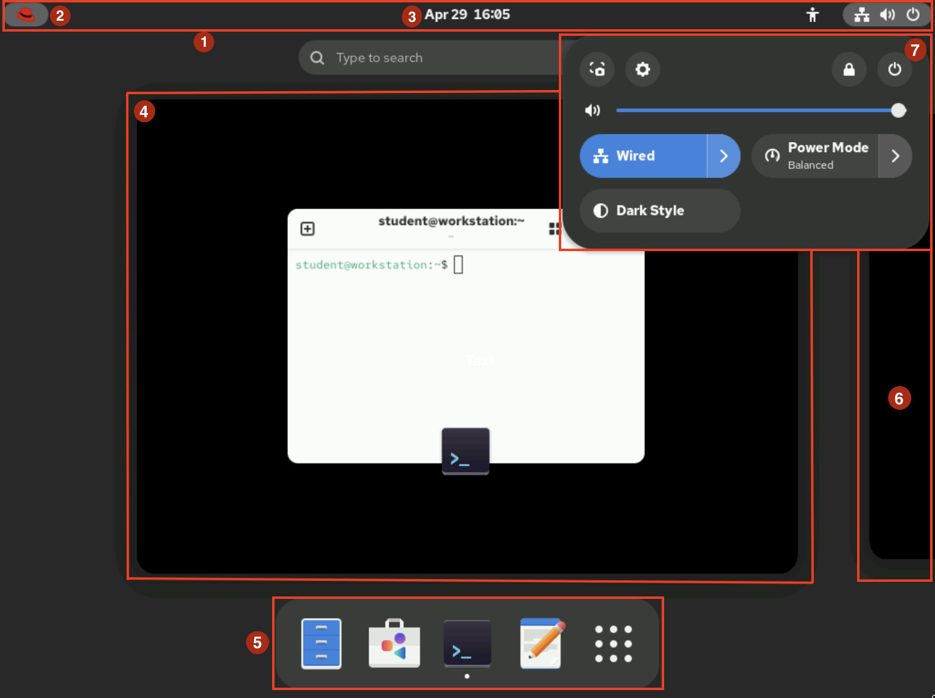
The GNOME Desktop & Interface Overview
1. Top bar: Stays visible continuously across workspaces; hosts Activities, notifications, and settings.
2. Activities Overview: Accessed via upper-left Red Hat logo or Super key to organize windows and launch apps.
3. Message tray: Displays notifications and calendar; toggled by clicking the clock or pressing Super + M .
4. Windows overview: Displays open window thumbnails in the current workspace to manage or move them.
5. Dash (Dock): Configurable list showing favorites, active applications, and the Show Applications icon.
6. Workspace selector: Located right of the windows overview to preview and toggle workspaces.
7. System menu: Upper-right controls for brightness, network/VPN toggles, dark style, screen recording, locking, and power.

Slide 11
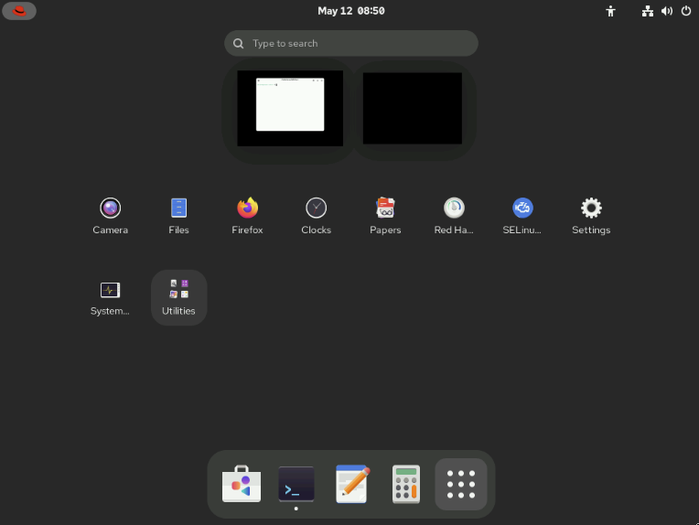
Workspace Management & Keyboard Navigation
Purpose: Isolate distinct tasks (e.g., server maintenance on one workspace, communication/email on another).
Switching Methods:
Keyboard: Ctrl + Alt + Left / Right Arrow
Graphical: Open Activities Overview and select from the workspace selector, or drag-and-drop windows between workspaces.
Modes (System menu → Settings → Multitasking):
Dynamic Workspaces (Default): Automatically creates workspaces when windows are dragged; removes empty ones.
Fixed Number of Workspaces: Keeps a static workspace count regardless of activity.
Shortcut Customization: System menu → Settings → Keyboard → View and Customize Shortcuts.
Virtual Machine Shortcut Challenge: The host OS or browser often intercepts special keys (e.g., Super, Ctrl + Alt).
On-Screen Keyboard Solution: Launch via the keyboard icon at the top right of the lab browser interface.
Treats modifier keys (Super, Shift, Ctrl, Alt, Caps) as sticky: click once to hold down (turns yellow), click twice to release.
Tip: Using the graphical workspace selector is easier in training labs than using intercepted key bindings.

Slide 12
Launching the Terminal in RHEL 10
1. Via Dash
Action: Open Activities Overview → Click the Terminal icon in the dash (or locate it via Show Applications).
3. Run Dialog
Press Alt + F2 to open the Run a Command window, enter ptyxis, and press Enter.
2. Via Search
Acion: Type terminal directly into the search field located at the top of the windows overview.
Shell Indicator: When launched, the shell prompt and title bar immediately display the active username, hostname, and current working directory.

Slide 13
Session Security & Power Controls
Screen Lock | Log Out | Power Off / Reboot
Action: Locks display to curtain mode | Action: Ends current graphical session | Action: Shuts down or restarts the machine
Execution: • System menu → Lock icon • Shortcut: Super + L (or Win + L) • Auto-locks after idle period | Execution: • System menu → Power icon → Log Out • Confirm in modal dialog | Execution: • System menu → Power icon → Power Off / Restart • Shortcut: Ctrl + Alt + Del
Unlock: Press Enter/Space or click; then type user password | Outcome: Closes active session; returns to RHEL 10 login screen | Auto-Trigger: Runs automatically after 60 seconds if unconfirmed. Option: Uncheck "Install pending software updates" if updates are not desired.

Slide 14
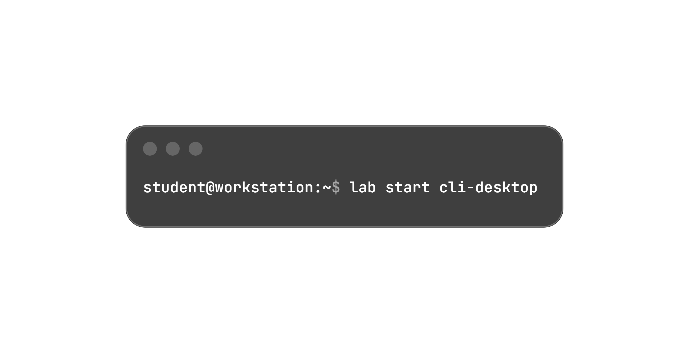
Guided Exercise: Access the Command Line with Desktop
Goal: Log in to a Linux system with the GNOME desktop environment and run commands from a shell prompt in a terminal program.
Outcomes:
  Log in to a Linux system by using the GNOME desktop environment.
  Run commands from a shell prompt in a terminal program.
Machine: workstation
User Account: student
Initialization Command: Run on workstation to prepare environment and ensure all resources are available:

Slide 15
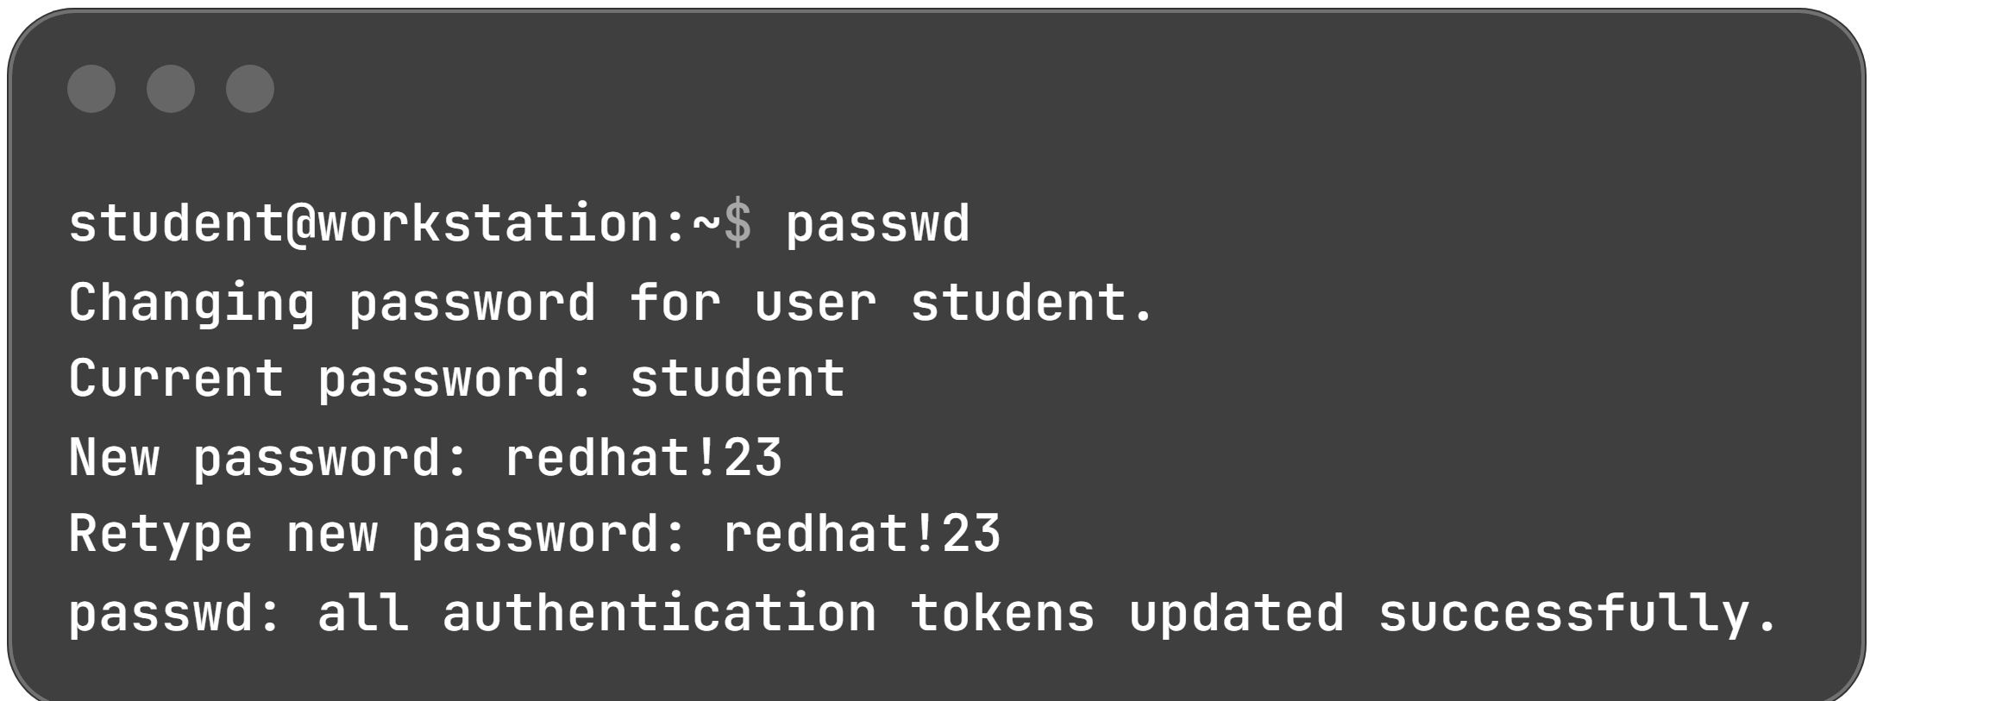
Hands-on Steps: Session & Password Management
3. Password Verification:
Log out from system menu.
Log back in as student using new password: redhat!23 → Press Enter.
1. Log Out & Initial Login:
Click upper-right system menu → Power icon → Log Out → Confirm Log Out.
Select student on GNOME login screen → Enter password: student → Press Enter.
2. Open Terminal & Change Password:
Press Super key twice (or click upper-left Red Hat logo) → Type terminal → Press Enter.
Run passwd command at prompt to update password to redhat!23:

Slide 16
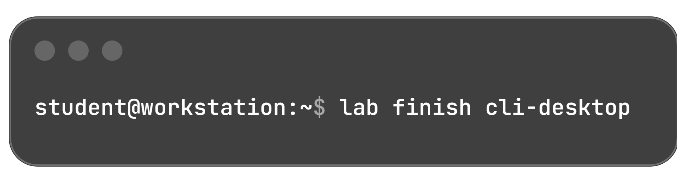
Screen Locking, Power Verification & Lab Cleanup
1. Screen Lock & Unlock | 2. Shutdown Inspection | 3. Finish & Clean-up
Lock: • System menu → Click Lock icon. Unlock: • Press Enter. • Password field: enter redhat!23 • Press Enter. | Action: • System menu → Power icon → Power Off. • Dialog displays options: Cancel or Power Off. • Click Cancel (inspect without shutting down). | Importance: • Resets student password back to student. • Prevents previous exercise resources from impacting upcoming exercises.
Lab Finish Command (Run in terminal):

Slide 17
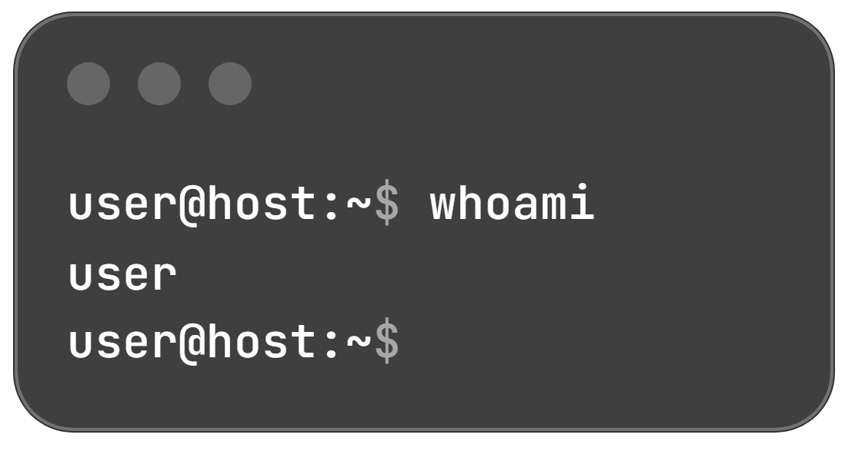
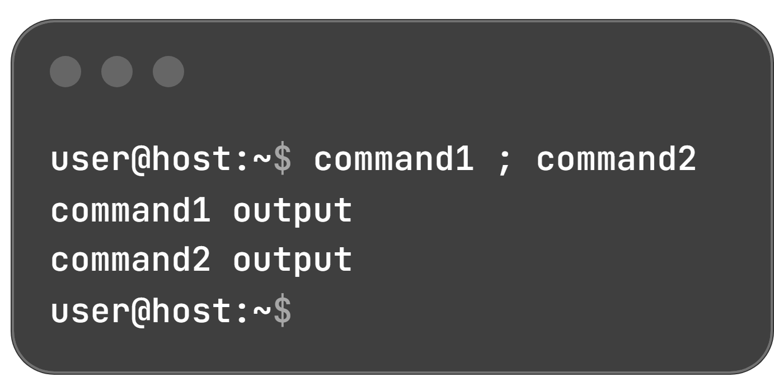
Bash Command Syntax & Execution Rules
Single Command: Produces output, followed by a new prompt:
Role: GNU Bash interprets user-typed commands (names of installed programs).
3 Core Components:
Command: The executable program name.
Options: Modify behavior; usually start with - (short) or -- (long).
Arguments: The operational targets of the command.
Formatting: Words must be separated by spaces; commands are typed on separate lines and run by pressing Enter.
Command Chaining (Semicolon ;):
Semicolon is a metacharacter with special interpretation in Bash.
Combines multiple commands on a single line; outputs from all commands display before the next prompt appears:

Slide 18
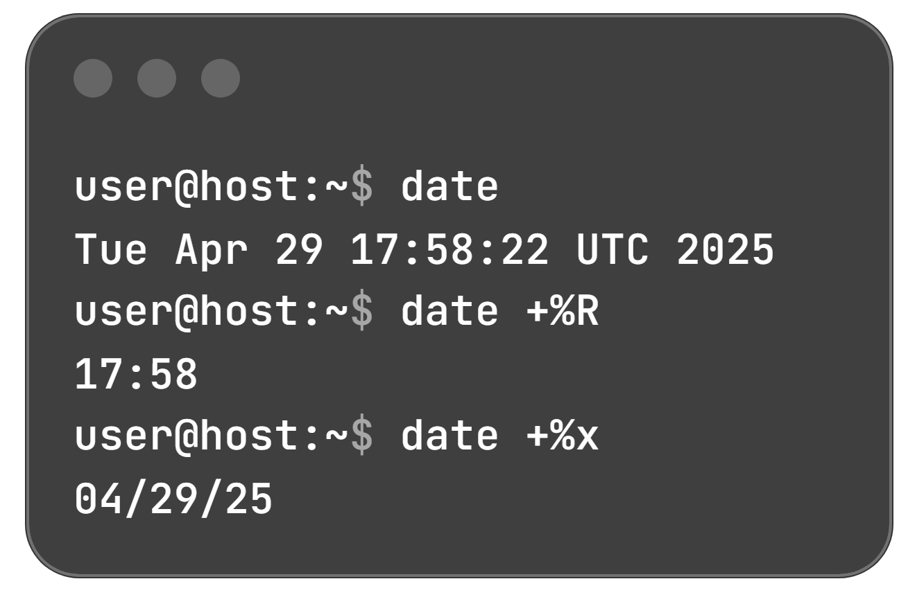
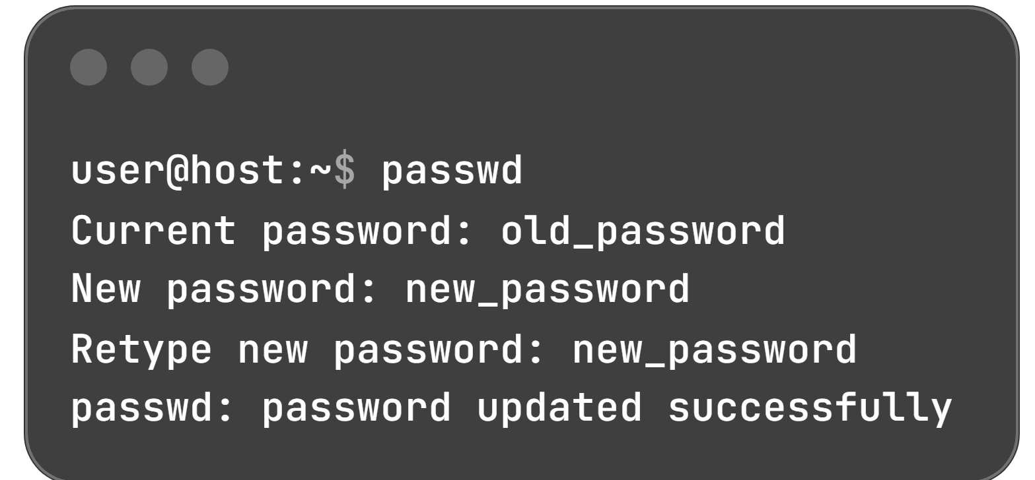
Simple Utility Commands
2. passwd (Credential Management)
Changes current user's password (requires entering current password first).
Superuser/privileged user can change another user's password.
Default policy enforces strong passwords (mixed case, numbers, symbols; no dictionary words):
1. date (System Clock & Time)
Displays current date and time (superuser/privileged users can set system clock).
Use the plus sign (+) argument for custom format strings:

Slide 19
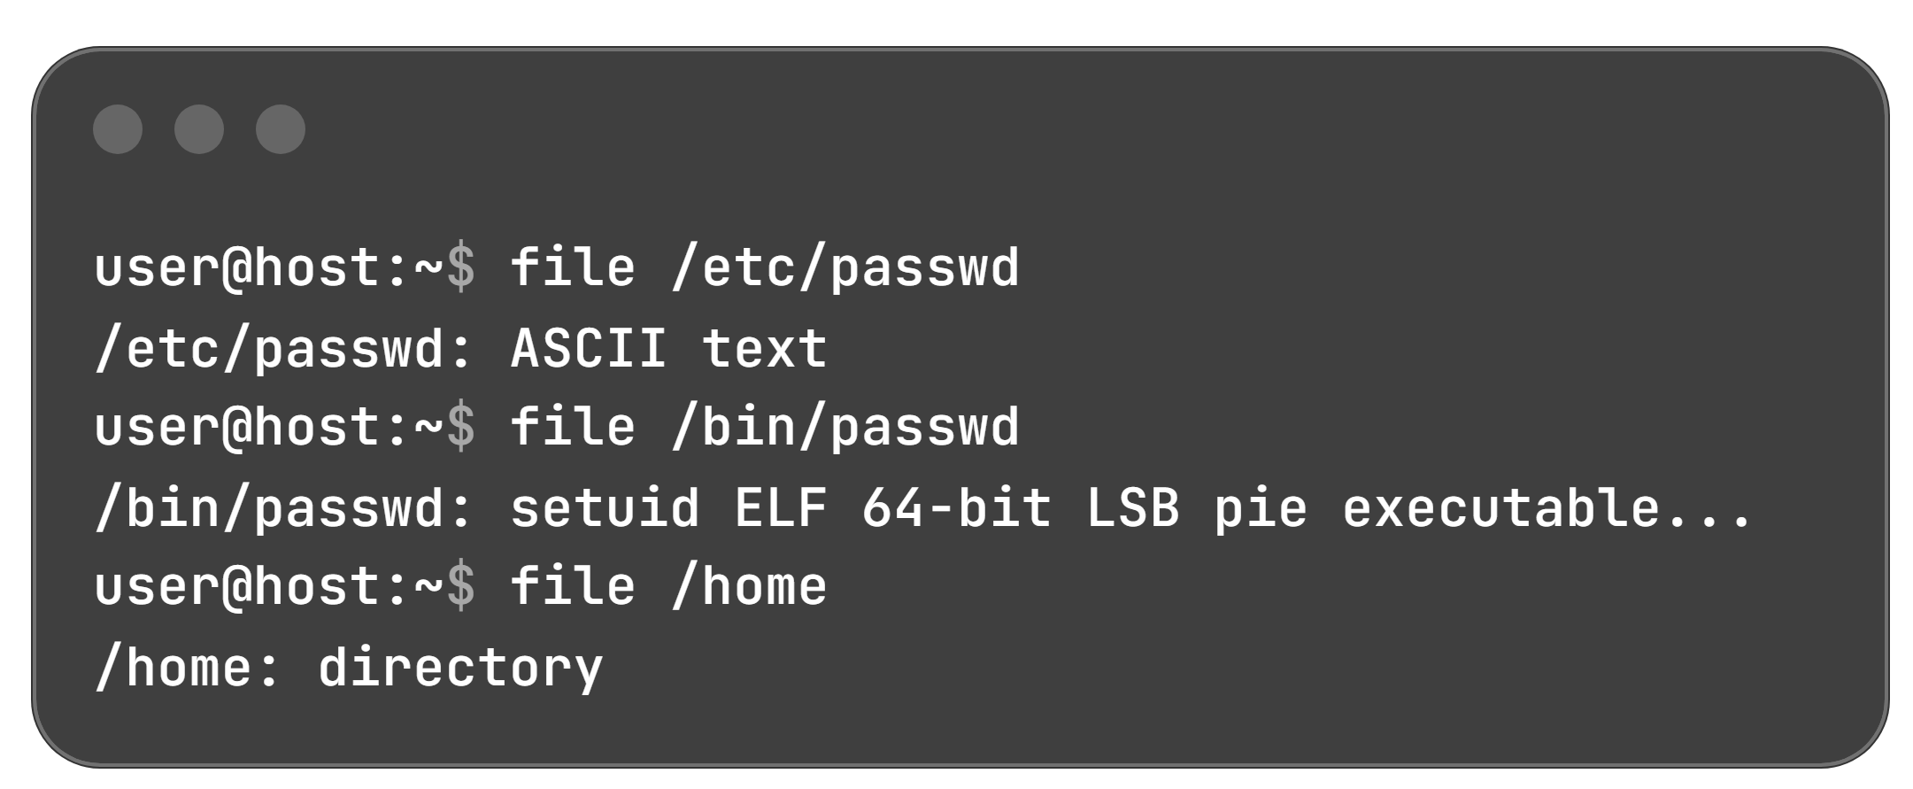
Simple Utility Commands
3. file (File Type Identification)
Linux does not rely on file extensions to determine types.
Scans the compiled header for a 2-digit magic number; recognizes uncompiled text files:

Slide 20
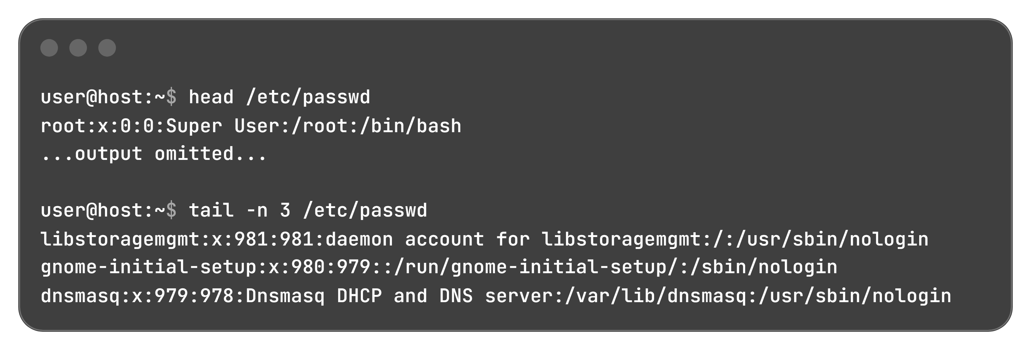
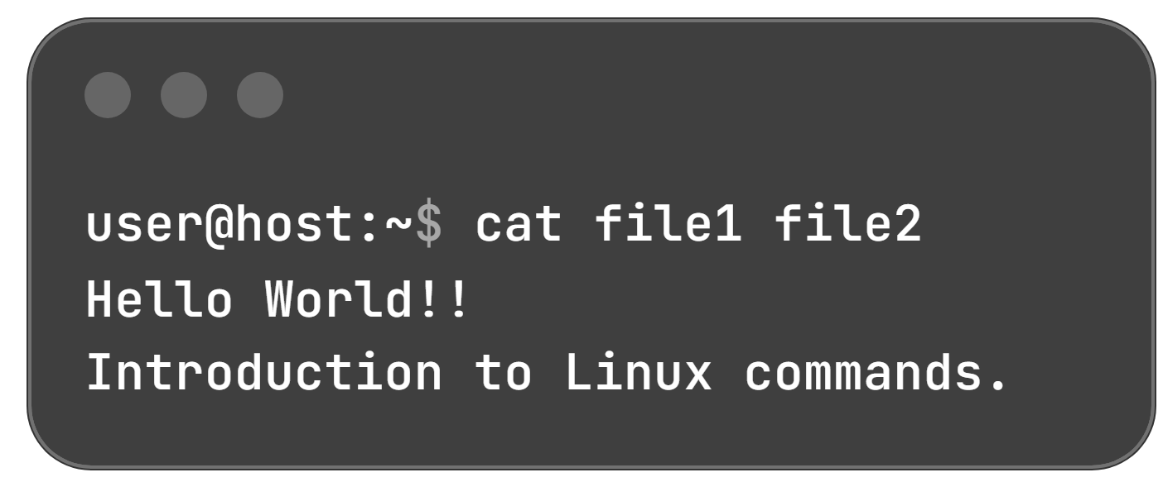
Viewing File Contents: Full, Paged & Sectioned
cat Utility:
Concatenates, creates, and views full file contents; redirects output to files or terminal.
Can display multiple files sequentially:
head: Displays file beginning (default: first 10 lines).
tail: Displays file ending (default: last 10 lines).
-n Option: Customizes the number of output lines:
less Pager:
For long files exceeding terminal window height (cat does not paginate).
Displays one page at a time with scroll controls:
  UpArrow / DownArrow: Scroll up and down.
  Q: Exit the viewer.

Slide 21
Counting File Statistics with
The wc Command: Counts lines, words, and characters within target files.
Option | Flag Description | Output Detail
(None) | Default execution | Prints line count, word count, byte/char count, and filename
-l | Lines | Displays only the number of newline lines
-w | Words | Displays only the number of words
-m | Characters | Displays only the total character count

Slide 22
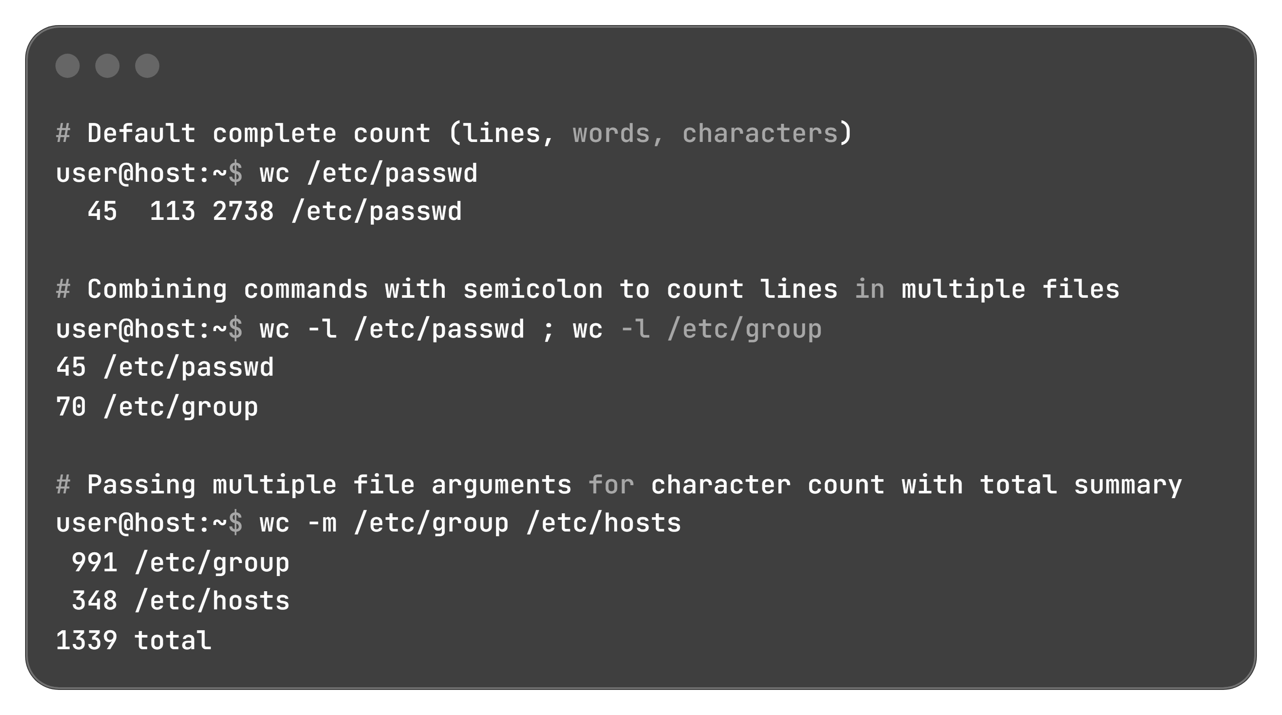
Counting File Statistics with
Command Variations

Slide 23
Speeding Up Input with Tab Completion
The Tab Key Functionality:
Unique Match: Automatically completes command names, file paths, or option flags.
Non-Unique Match: Pressing Tab twice lists all possible completions matching the entered characters.
Target Type | Shell Input & Action | Output / Behavior
Commands | user@host:~$ pas + [Tab][Tab] user@host:~$ pass + [Tab][Tab] user@host:~$ passw + [Tab] | Lists matching binaries (passt, passwd, etc.) Narrows choices down Auto-completes to passwd and triggers prompt
File Arguments | user@host:~$ ls /etc/pas + [Tab] user@host:~$ ls /etc/passwd + [Tab] | Auto-completes up to common prefix /etc/passwd Pressing Tab again displays: passwd passwd-
Long Options | root@host:~# useradd -- + [Tab][Tab] | Displays all available long flags (--home-dir, --shell, --uid, etc.) without needing manual lookup

Slide 24
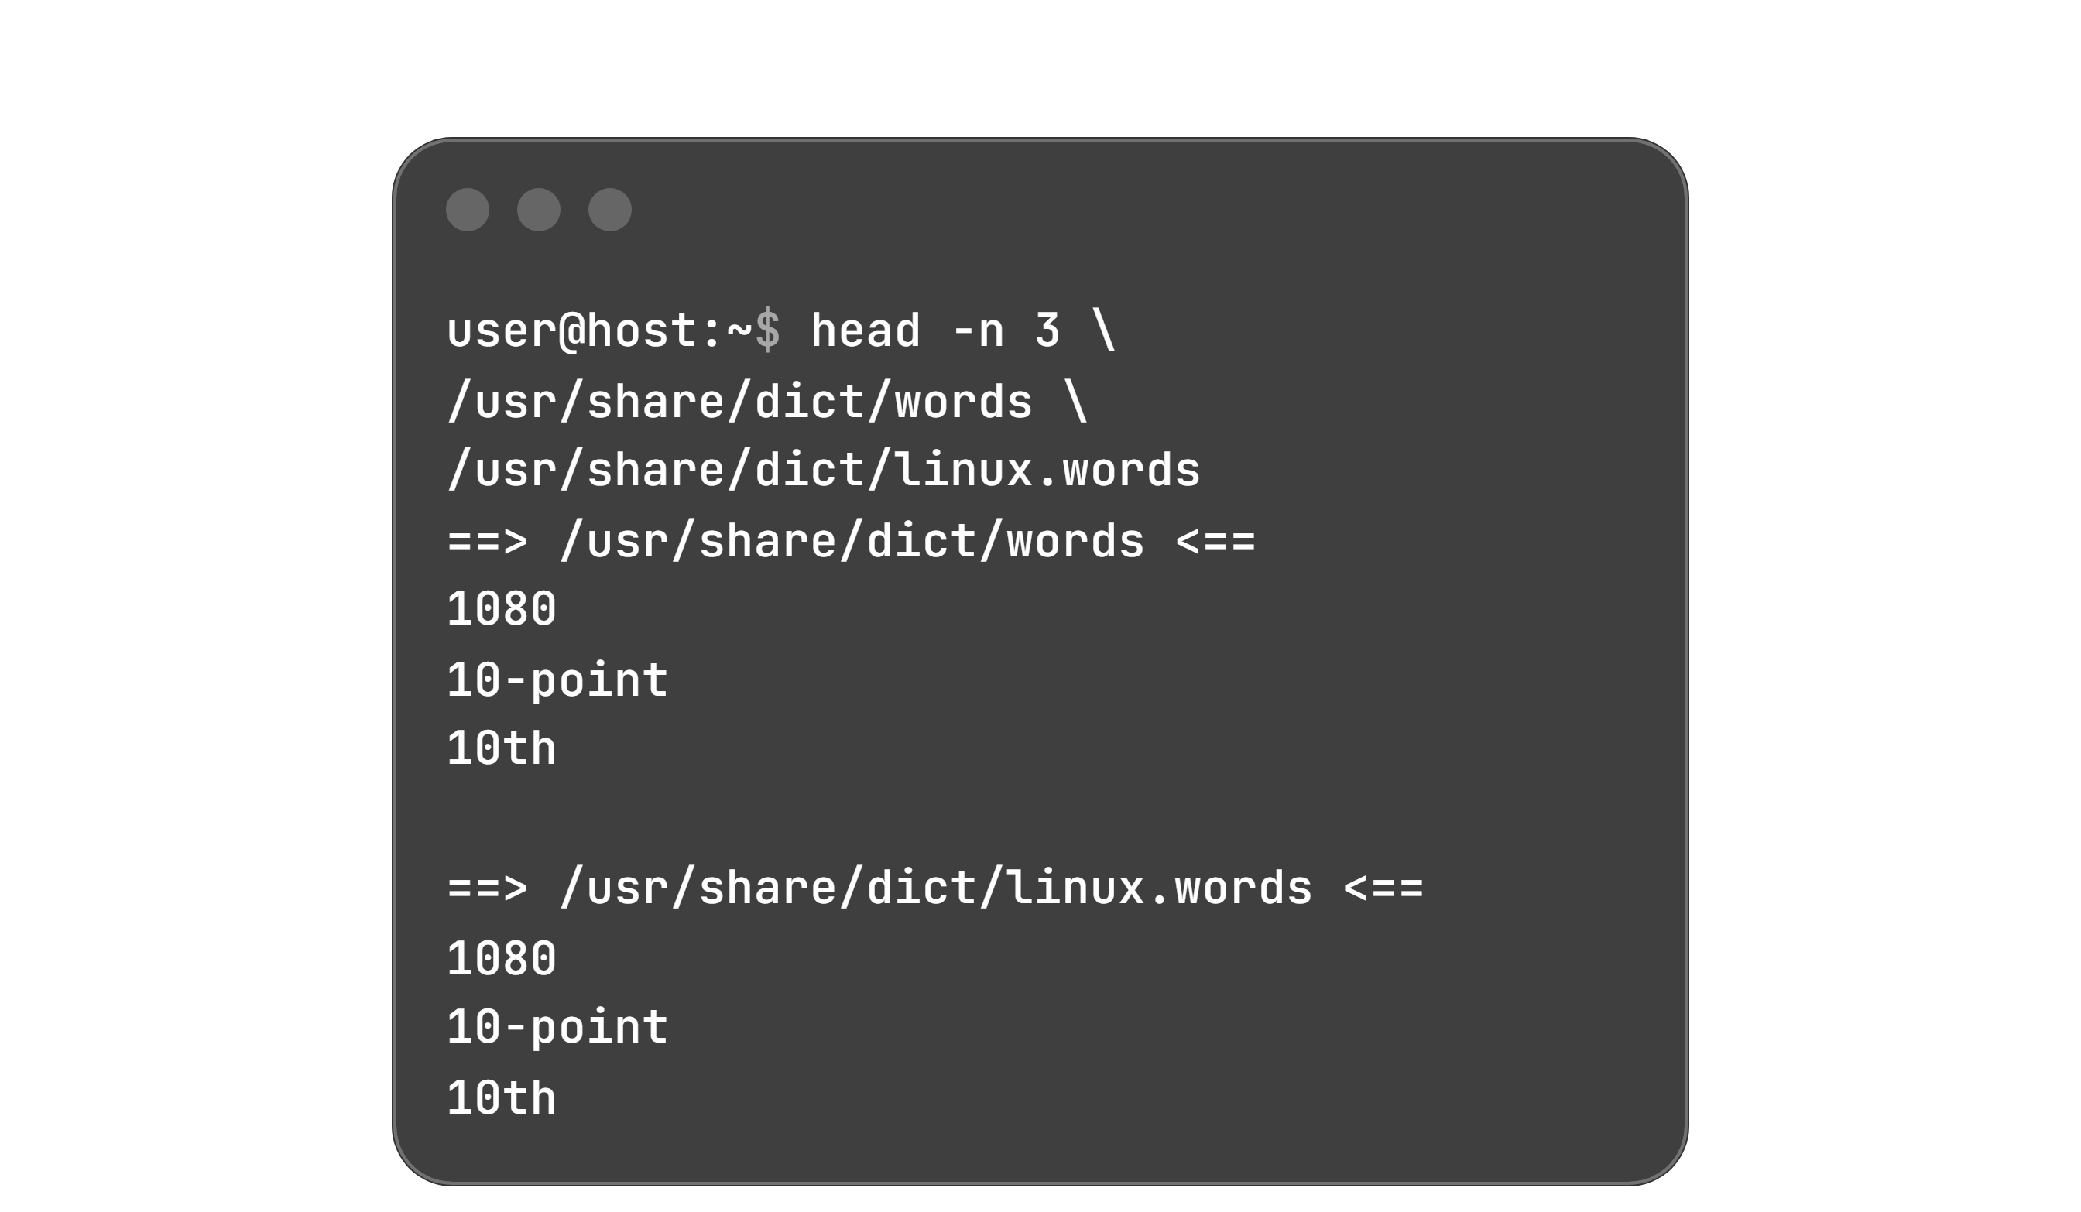
Multi-Line Long Commands
The Problem: Commands with multiple options and targets grow long and wrap awkwardly at the terminal margin.
The Solution: Use the backslash (\) escape character at the end of a line.
Mechanics:
  Escapes the newline character (Enter).
  Moves the cursor to a new line without executing the command.
  Spawns a secondary continuation prompt (> by default).
Important Caution on > Prompt: The shell automatically presents > as the continuation prompt. Do not type >; entering > manually causes unintentional shell output redirection.

Slide 25
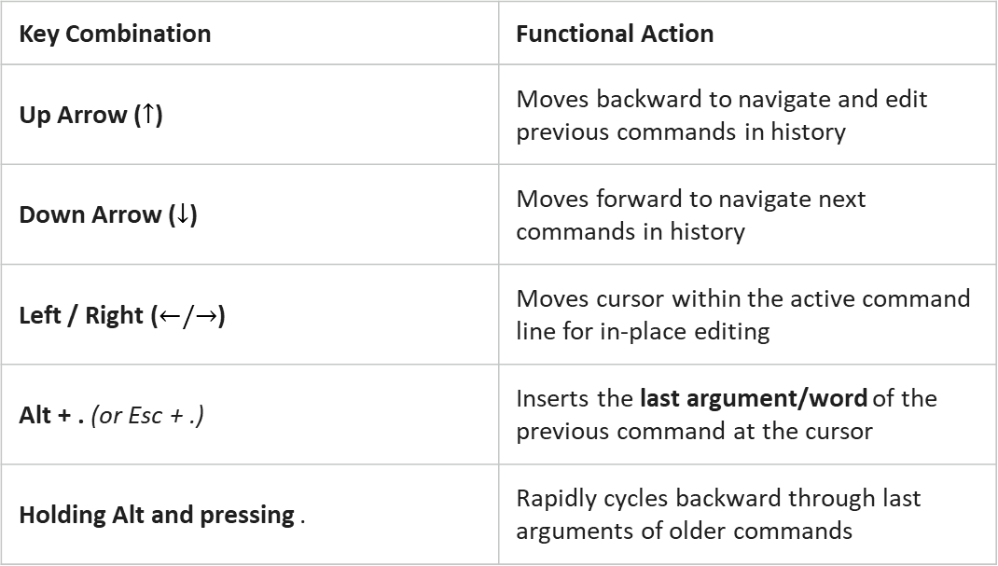
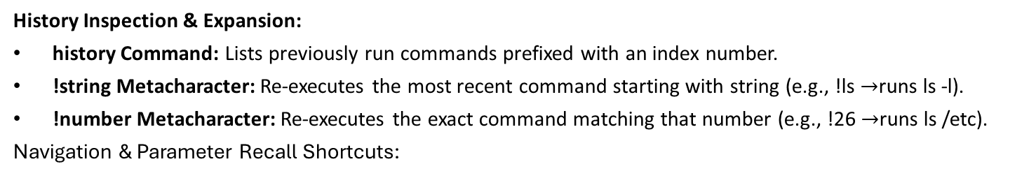
Command History & Navigation Shortcuts
History Inspection & Expansion:
history Command: Lists previously run commands prefixed with an index number.
!string Metacharacter: Re-executes the most recent command starting with string (e.g., !ls $→$runs ls -l).
!number Metacharacter: Re-executes the exact command matching that number (e.g., !26 $→$runs ls /etc).
Navigation & Parameter Recall Shortcuts:
Key Combination | Functional Action
Up Arrow ($↑$) | Moves backward to navigate and edit previous commands in history
Down Arrow ($↓$) | Moves forward to navigate next commands in history
Left / Right ($←/→$) | Moves cursor within the active command line for in-place editing
Alt + . (or Esc + .) | Inserts the last argument/word of the previous command at the cursor
Holding Alt and pressing . | Rapidly cycles backward through last arguments of older commands

Slide 26
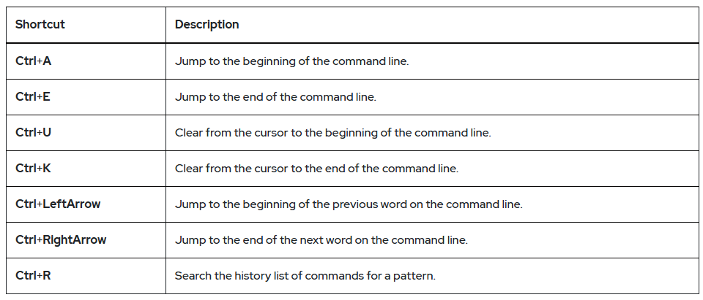
Interactive Command-Line Editing Shortcuts
Core Principle:
Bash provides built-in text-editing controls to quickly navigate, modify, and search commands interactively without manual retyping.
Key Editing & Navigation Shortcuts:

Slide 27
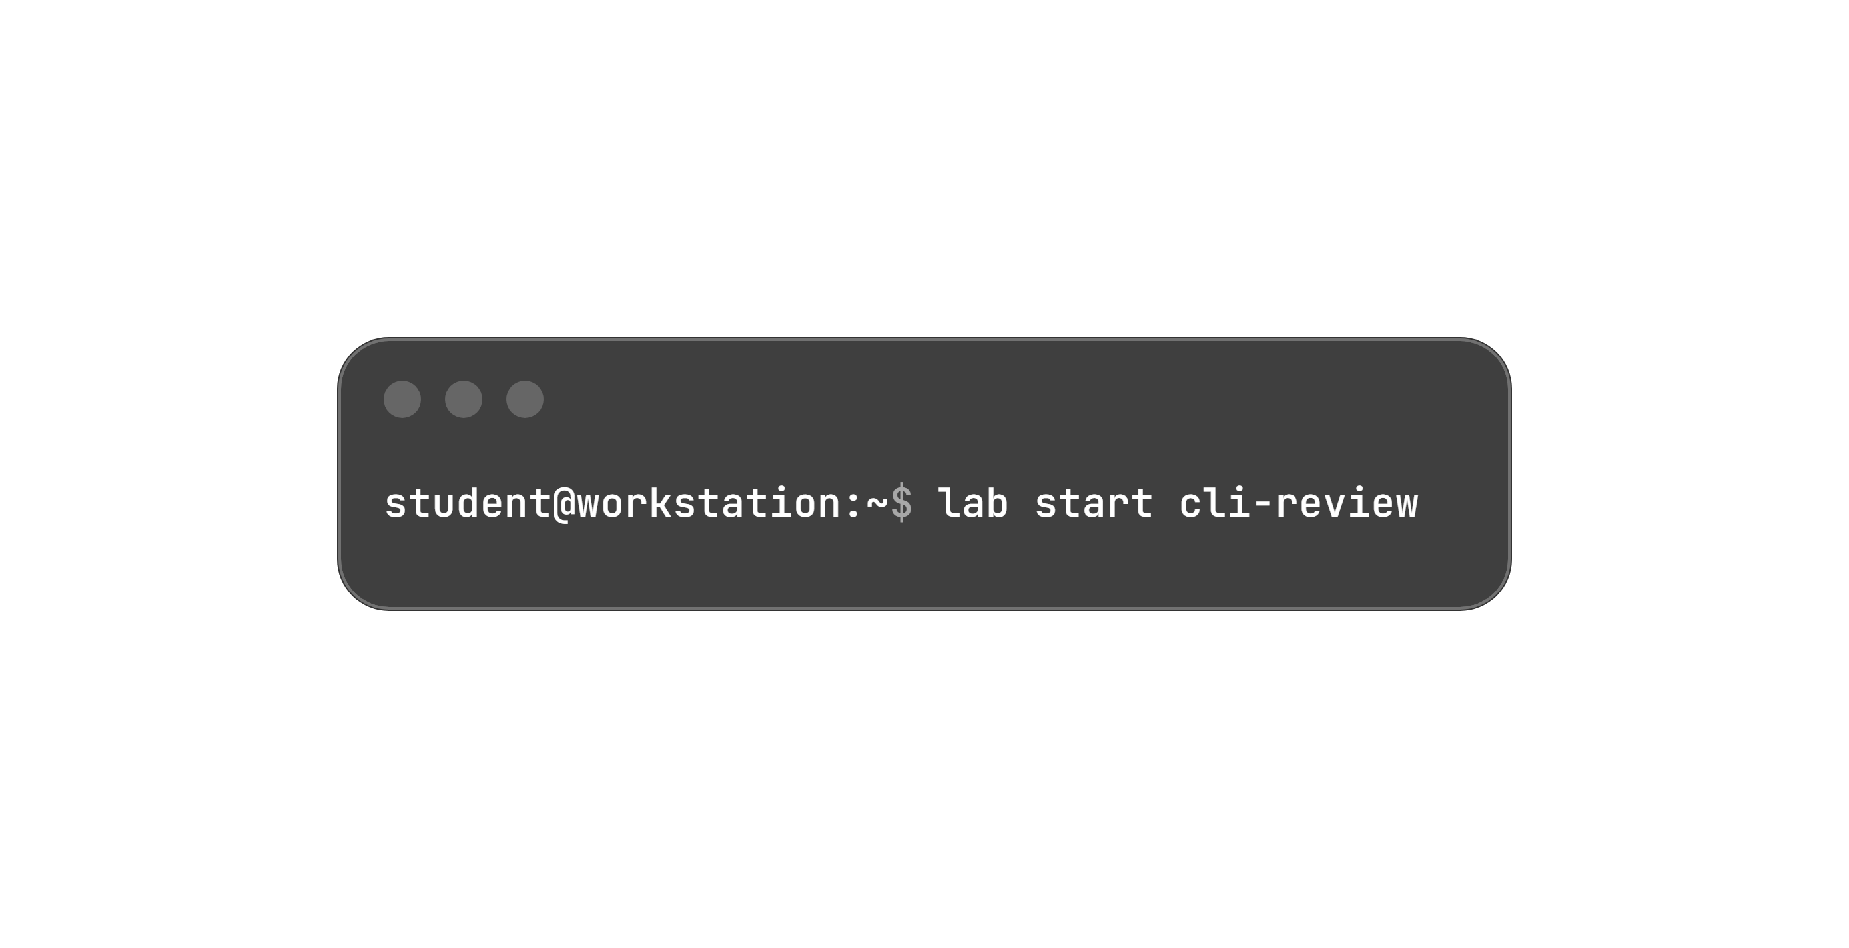
Lab Overview: Access the Command Line
Access the CLI: Access the command line on a Linux system and use the Bash shell to run commands.
Core Outcomes:
  Successfully run simple programs from the Bash shell command line.
  Execute commands to identify file types and display parts of text files.
  Practice Bash command history shortcuts to repeat commands or arguments efficiently.
Host: workstation
Account: student
Setup Action: Prepares the environment and ensures required resources are present:

Slide 28
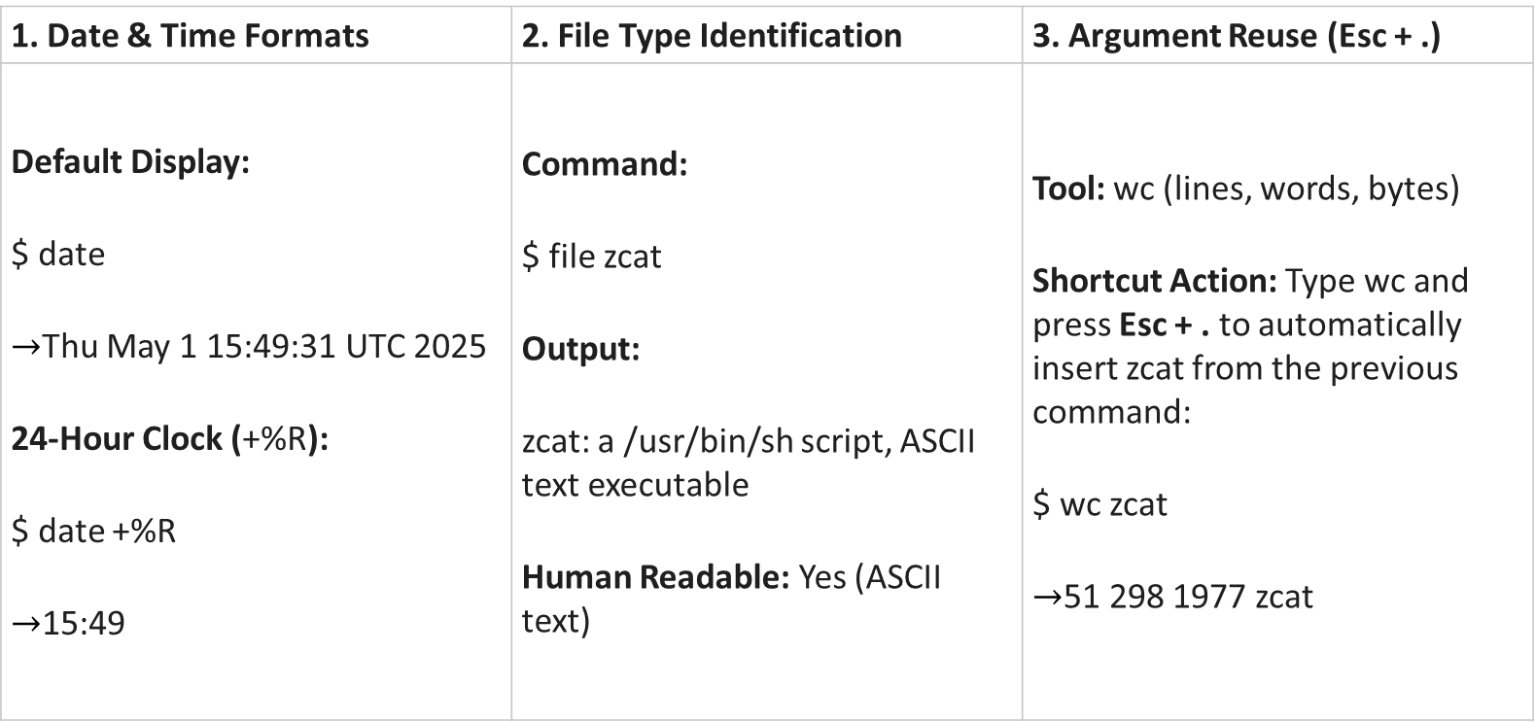
Time Formatting, File Inspection & Argument Reuse
1. Date & Time Formats | 2. File Type Identification | 3. Argument Reuse (Esc + .)
Default Display: $ date $→$Thu May 1 15:49:31 UTC 2025 24-Hour Clock (+%R): $ date +%R $→$15:49 | Command: $ file zcat Output: zcat: a /usr/bin/sh script, ASCII text executable Human Readable: Yes (ASCII text) | Tool: wc (lines, words, bytes) Shortcut Action: Type wc and press Esc + . to automatically insert zcat from the previous command: $ wc zcat $→$51 298 1977 zcat

Slide 29
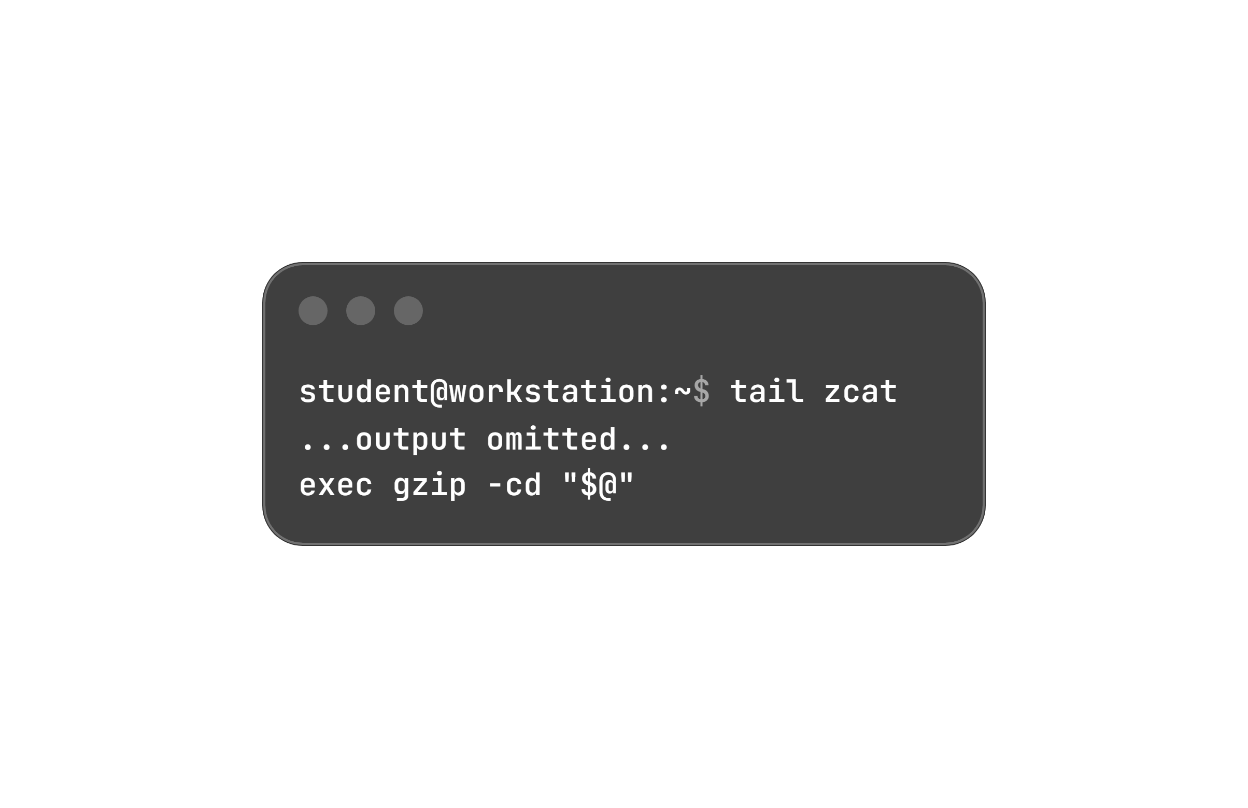
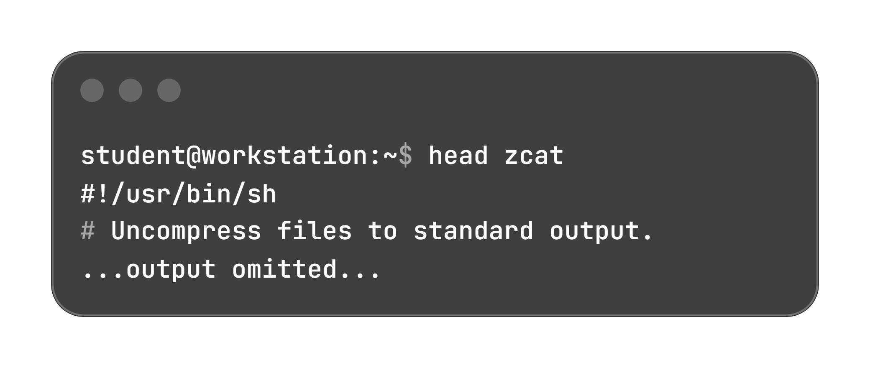
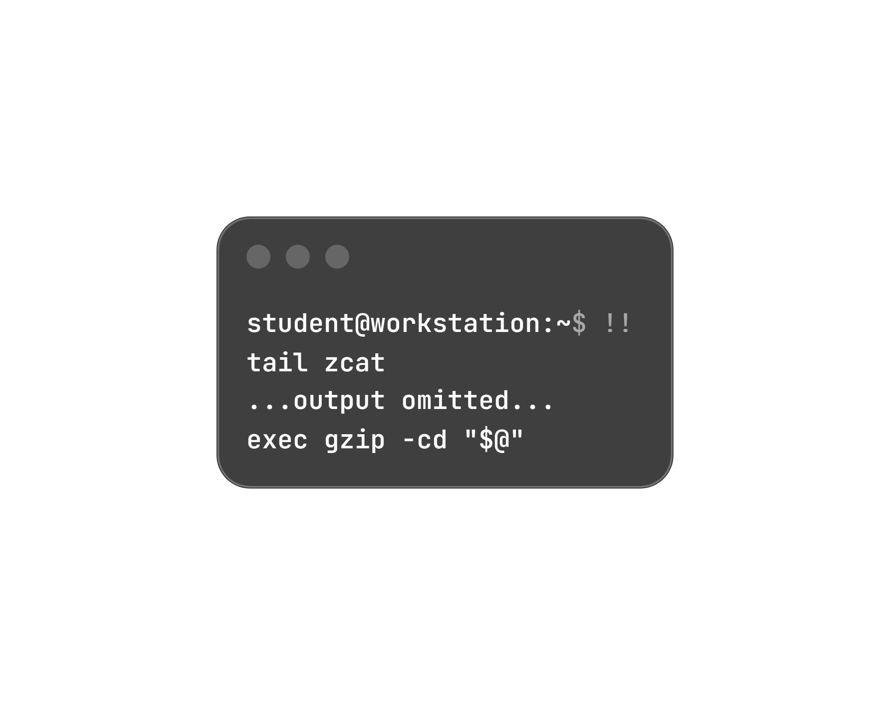
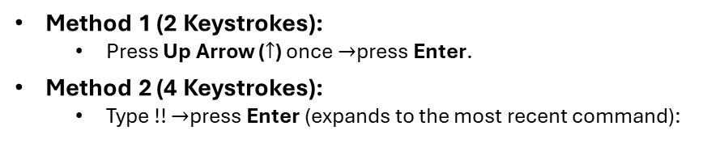
File Inspection & Fast Command Repetition
Display First 10 Lines:
Uses head with argument recall (Esc + .):
Display Last 10 Lines:
Uses tail with argument recall (Esc + .):
Method 1 (2 Keystrokes):
  Press Up Arrow ($↑$) once $→$press Enter.
Method 2 (4 Keystrokes):
  Type !! $→$press Enter (expands to the most recent command):

Slide 30
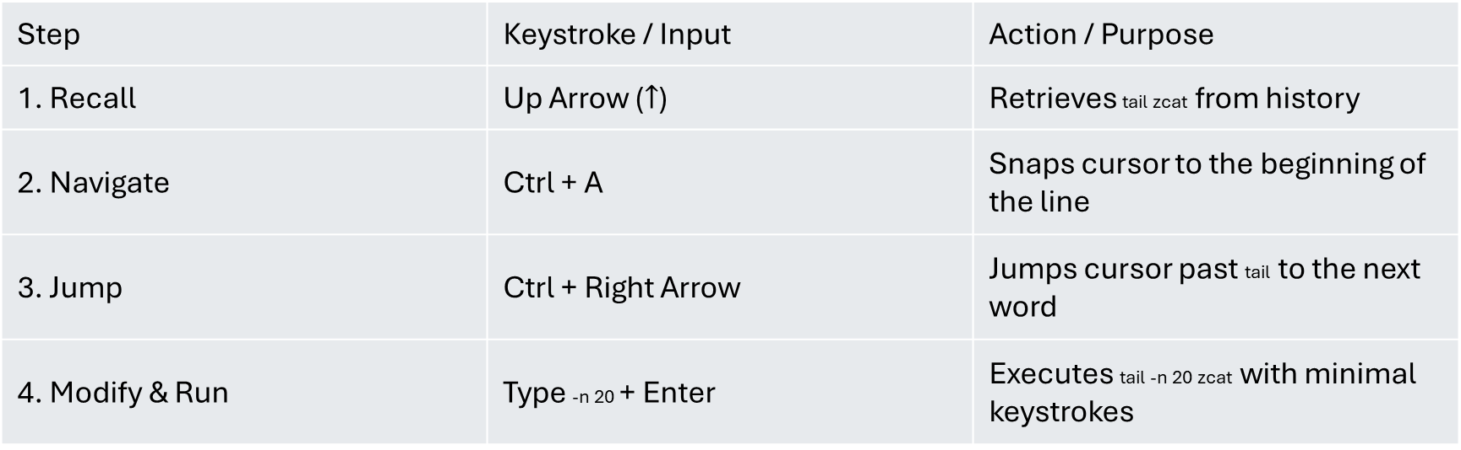
Interactive Line Editing, History Recall & Lab Completion
In-Place Editing Workflow (Showing Last 20 Lines):
Step | Keystroke / Input | Action / Purpose
1. Recall | Up Arrow ($↑$) | Retrieves tail zcat from history
2. Navigate | Ctrl + A | Snaps cursor to the beginning of the line
3. Jump | Ctrl + Right Arrow | Jumps cursor past tail to the next word
4. Modify & Run | Type -n 20 + Enter | Executes tail -n 20 zcat with minimal keystrokes

Slide 31
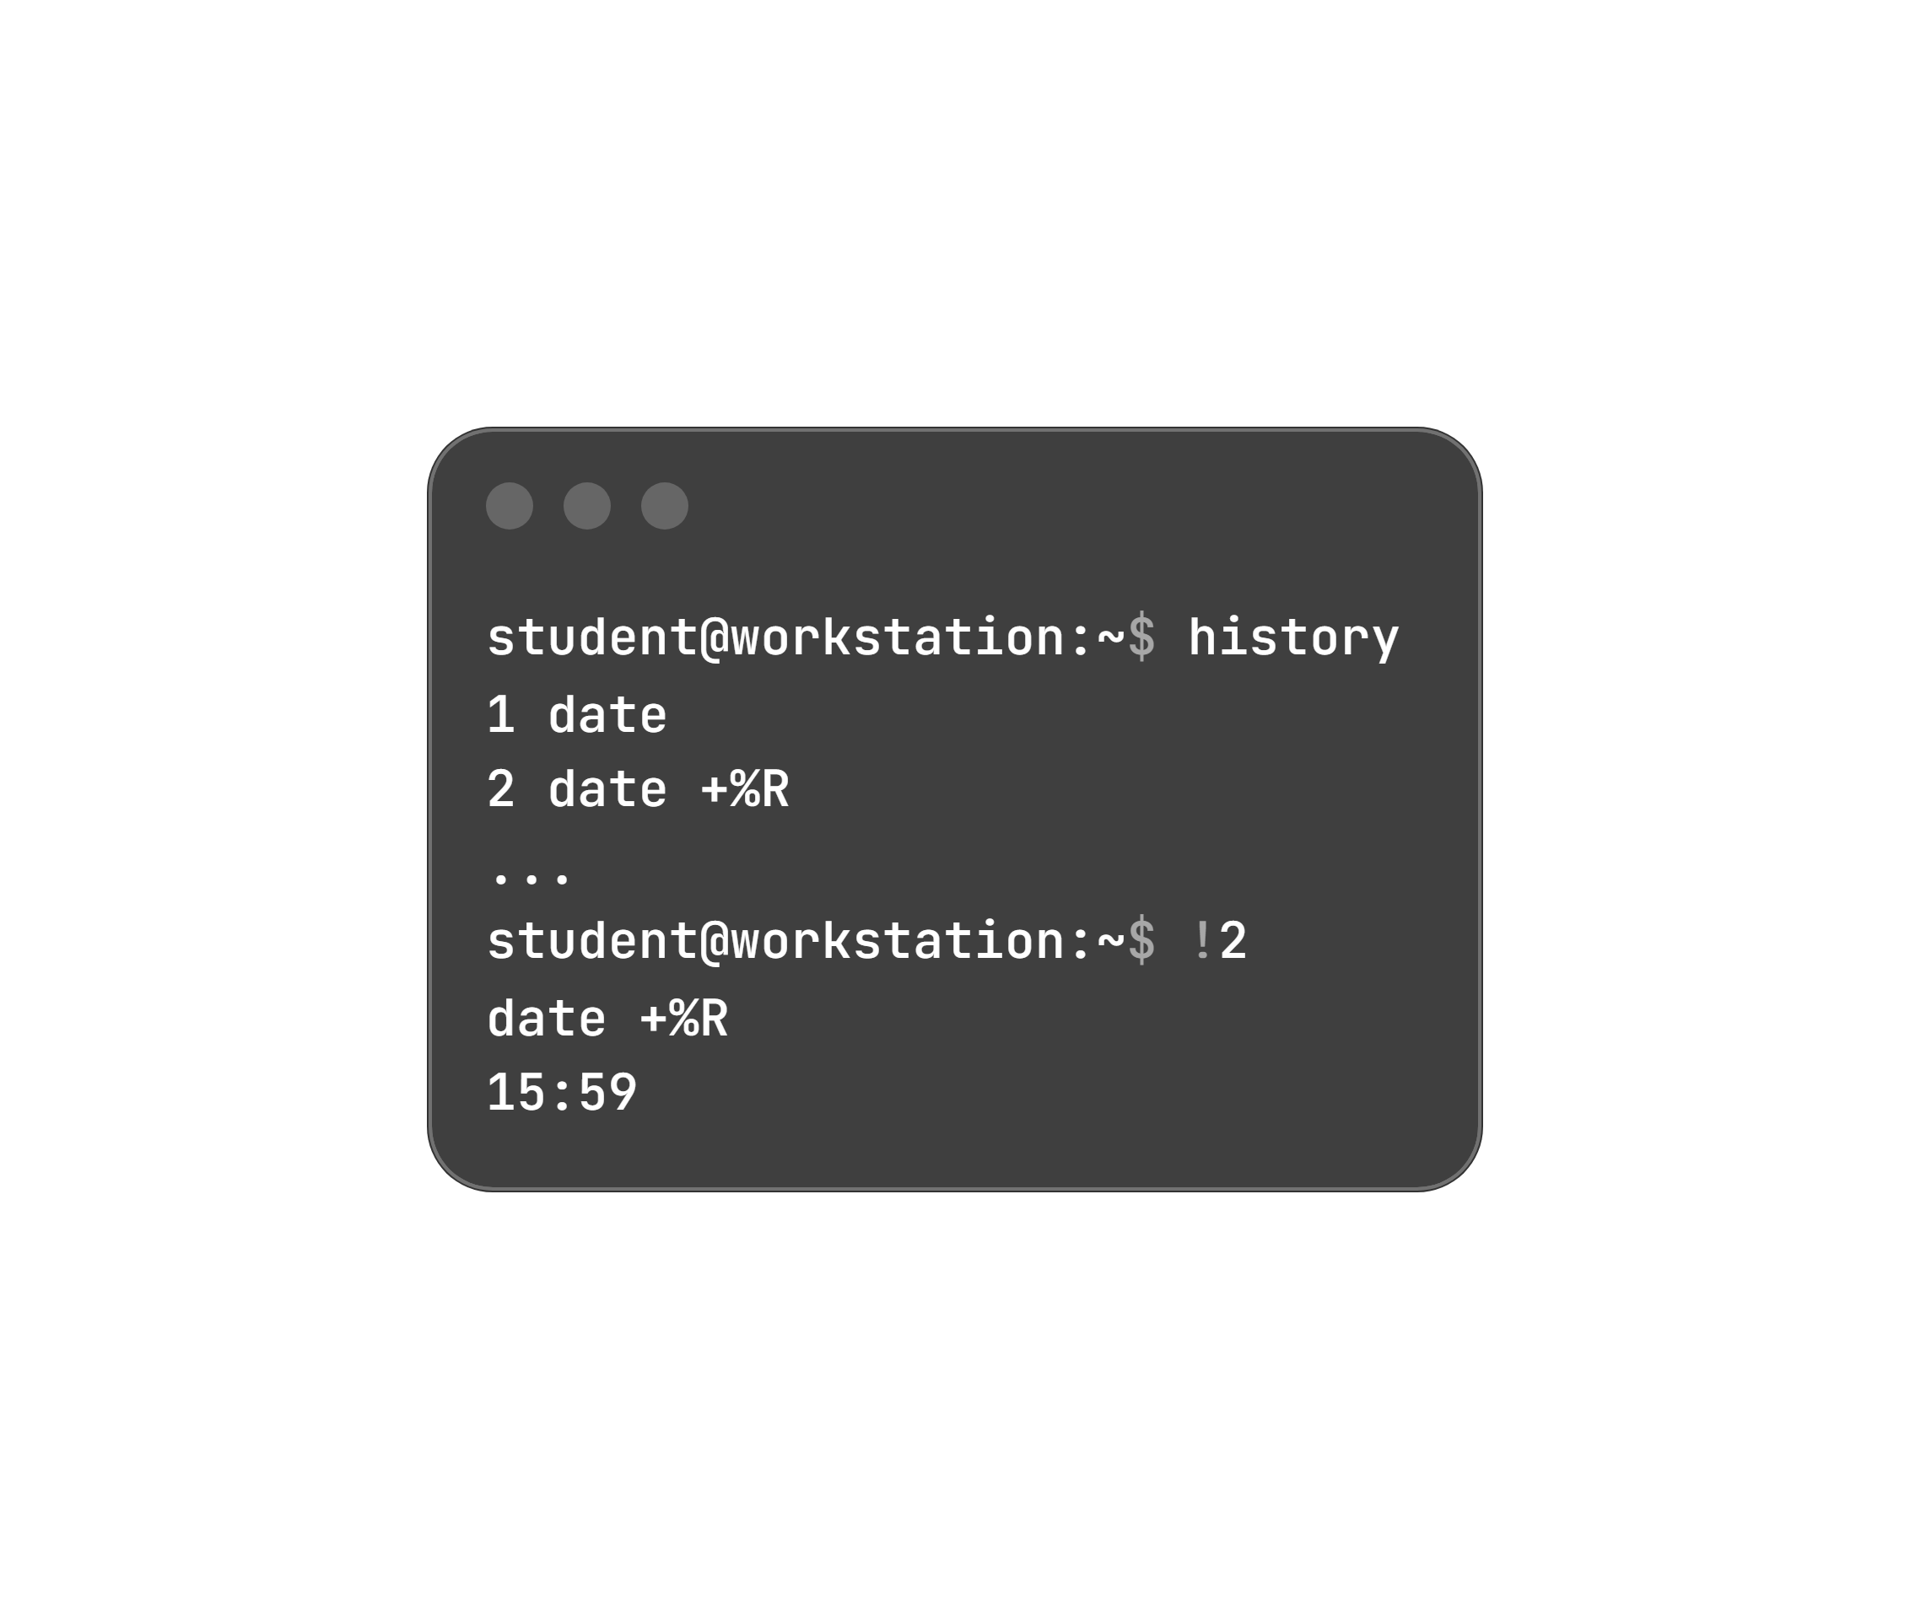
Interactive Line Editing, History Recall & Lab Completion
History Execution by Index Number:
Run history to identify the command index.
Re-execute target entry using !number:
Evaluation & Environment Teardown:
Grade Lab: Run $ lab grade cli-review (correct any reported failures until successful).
Finish & Reset: Change to home directory and run $ lab finish cli-review to clear resources.

